Slide 1
Lean Canvas

Slide 2
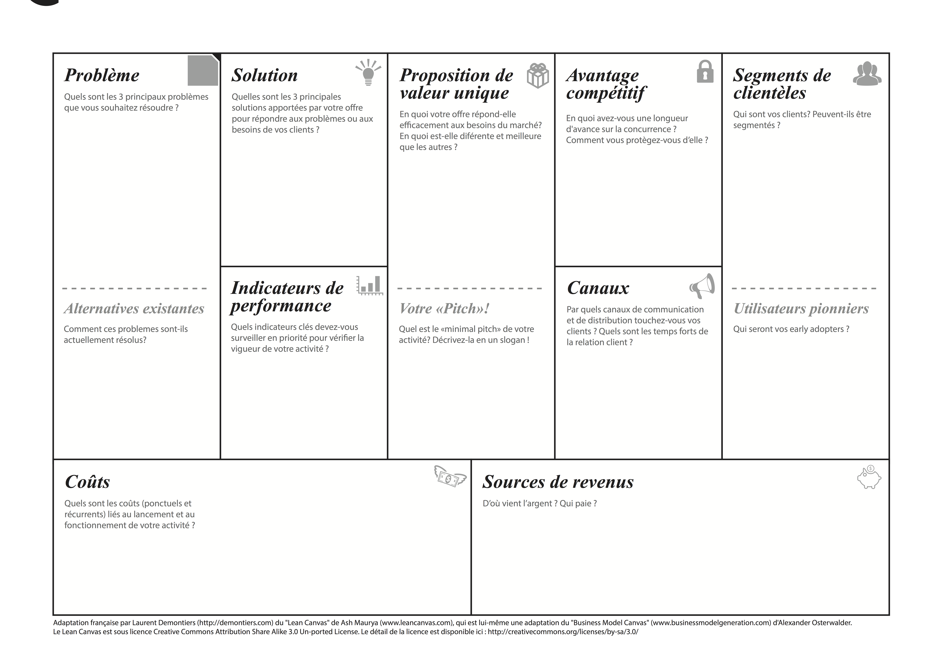
Notes:
Do this activity in small groups

Slide 3
merci

